Slide 1
Identifying the Factors That Affects the Player Ratings on FIFA 18
Youneng Zou

Slide 2
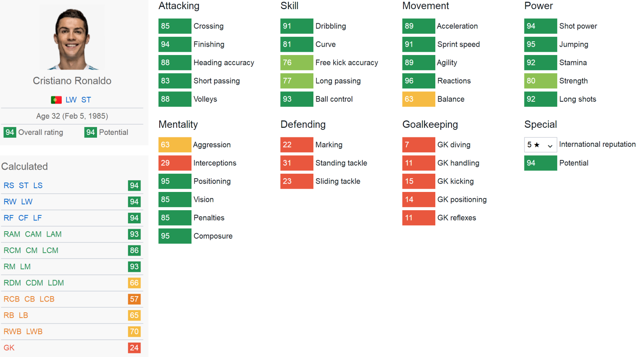
Background Introduction
Goal: Use linear model to estimate the player rating
There are 11 positions (left, right, center are the same)
There are different linear combinations of a player's main attributes (e.g. acceleration, finishing etc.) for different positions
This presentation: investigate how Attacking and Defending attributes affect the player’s rating at RS position

Slide 3
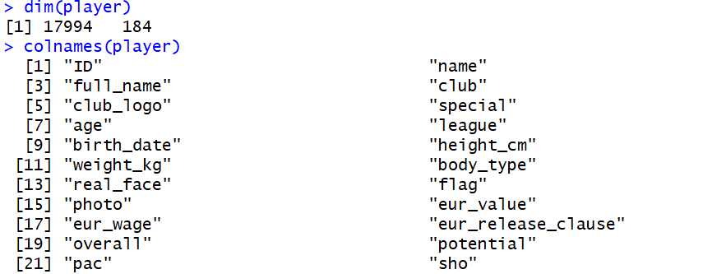
Data Cleaning
Retrieved From: Kaggle
Remove lots of useless columns

Slide 4
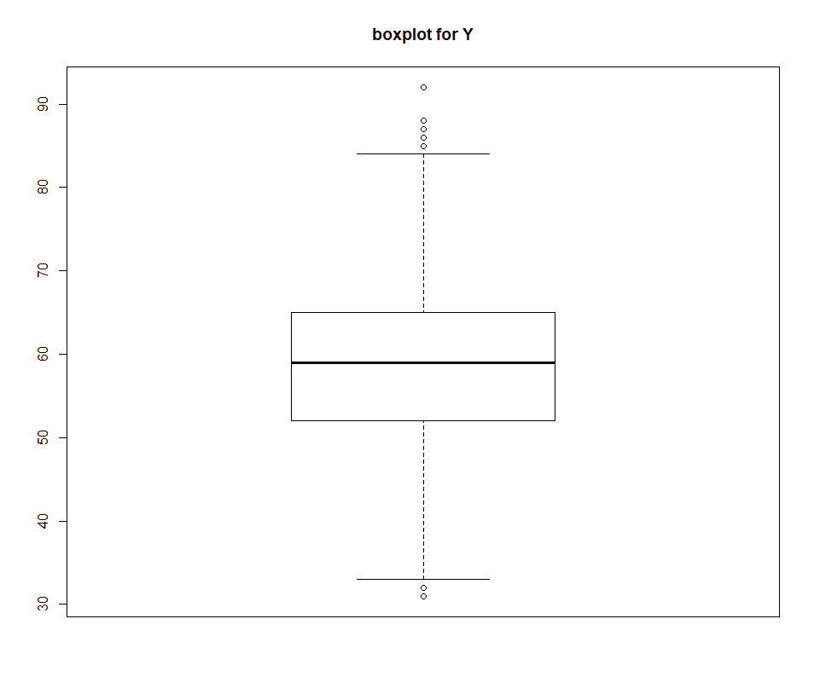
Data Cleaning
Some outliers above 85 and below 32 or 33
Remove them from the data

Slide 5
Variables
Response Variable:
1. RS: Ratings on right striker position (Numerical)
Explanatory variables:
1. international_reputation (Categorical)
2. crossing (Numerical)
3. finishing (Numerical)
4. heading_accuracy (Numerical)
5. short_passing (Numerical)
6. volleys (Numerical)
7. marking (Numerical)
8. standing_tackle (Numerical)
9. sliding_tackle (Numerical)

Slide 6
Full Model
RS = rs ~ international_reputation + crossing + finishing + heading_accuracy + short_passing + volleys + marking + standing_tackle + sliding_tackle + international_reputation*crossing + international_reputation*finishing + international_reputation*heading_accuracy + international_reputation*short_passing + international_reputation*volleys + crossing*marking + crossing*standing_tackle + crossing*sliding_tackle + heading_accuracy*marking + heading_accuracy*standing_tackle + heading_accuracy*sliding_tackle + short_passing*volleys + short_passing*marking + short_passing*standing_tackle + short_passing*sliding_tackle

Slide 7
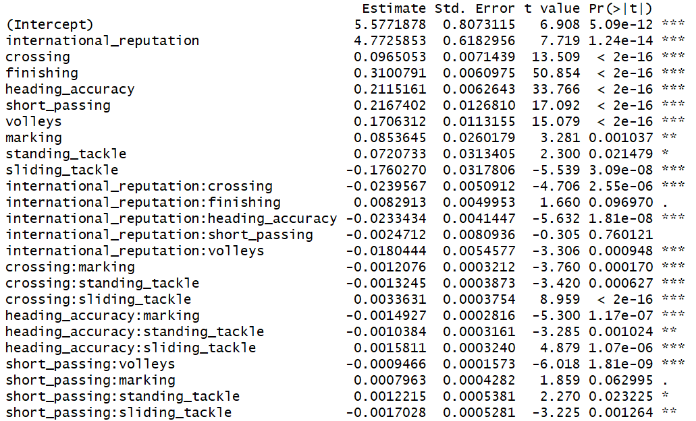
Full Model Summary
Estimated σ | 2.3
R2 | 0.94
F-statistic | 9742
p-value | 2.2e-16

Slide 8
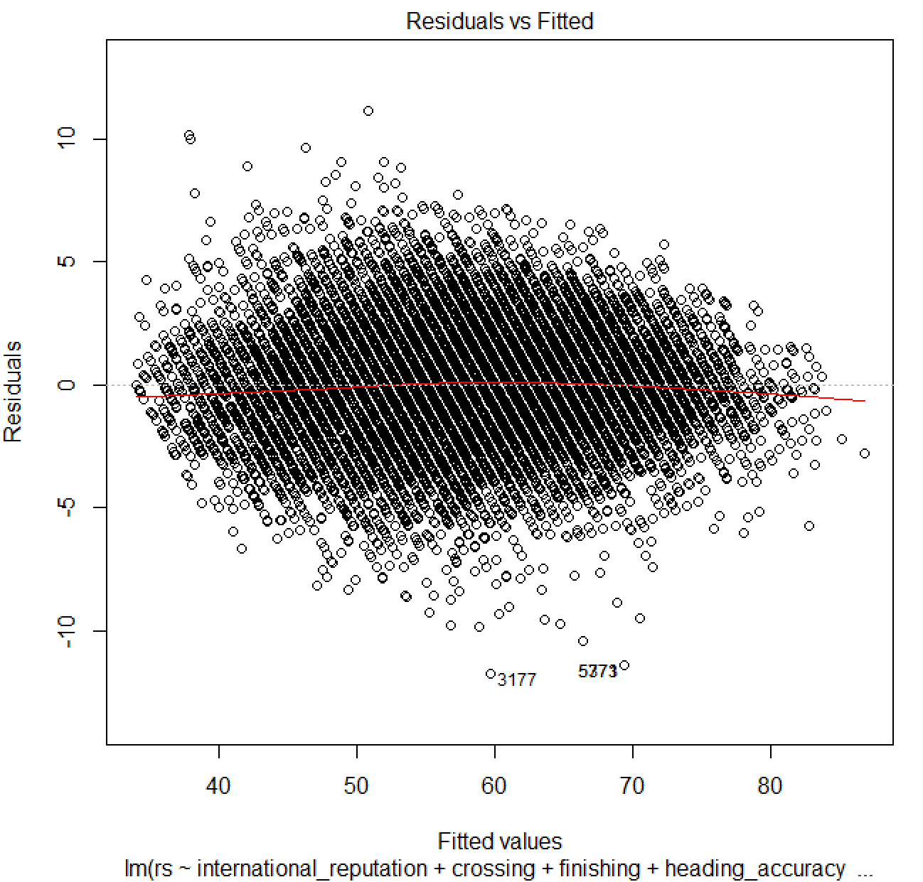
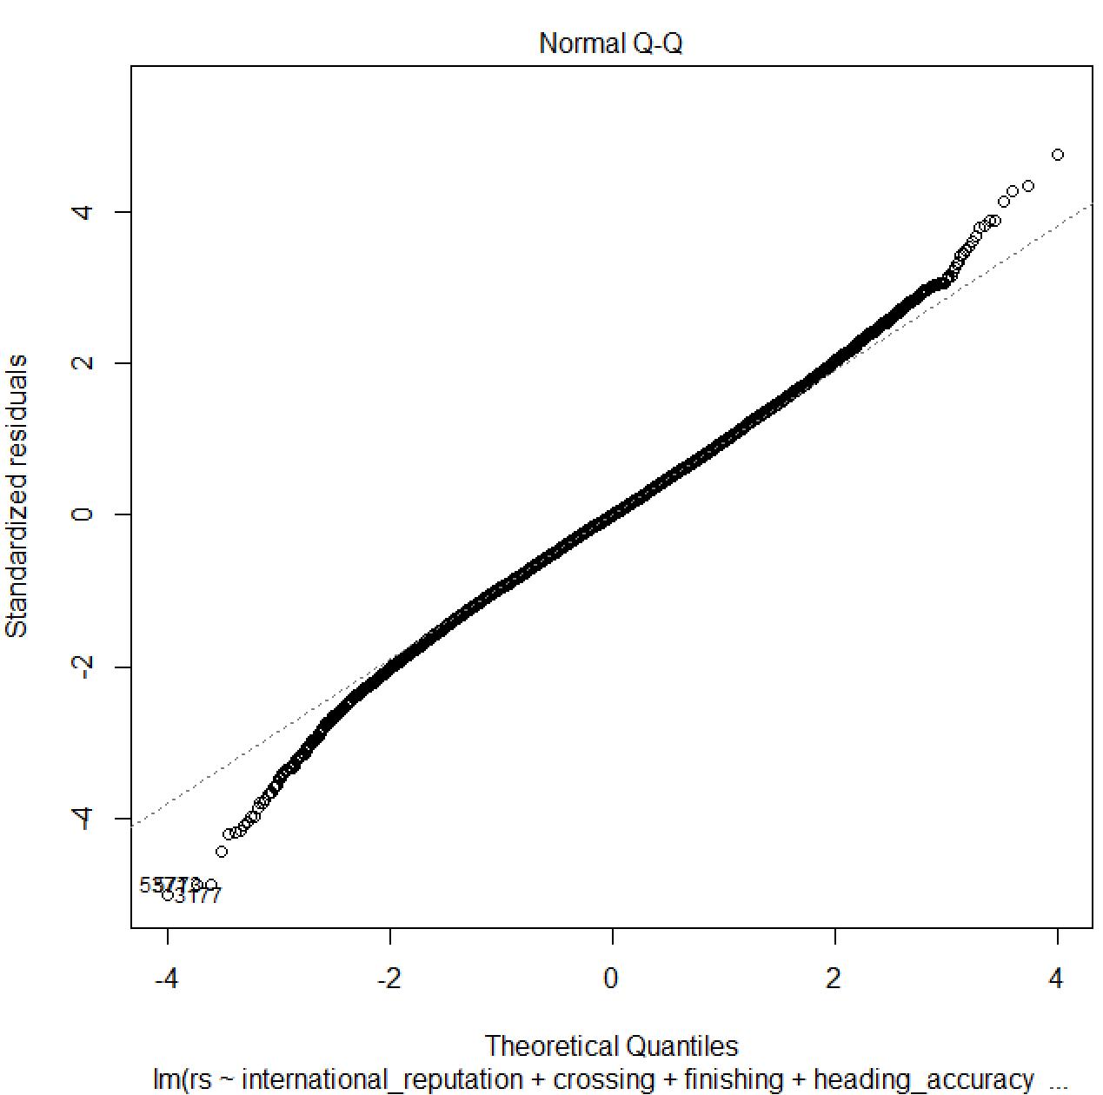
Full Model

Slide 9
Model Selection
Information Criteria | Direction | AIC/BIC Value
AIC | Forward | 26504.1
AIC | Backward | 26504.1
AIC | Both | 26504.1
BIC | Forward | 26720.15
BIC | Backward | 26662.64
BIC | Both | 26662.64
Same
Model

Slide 10
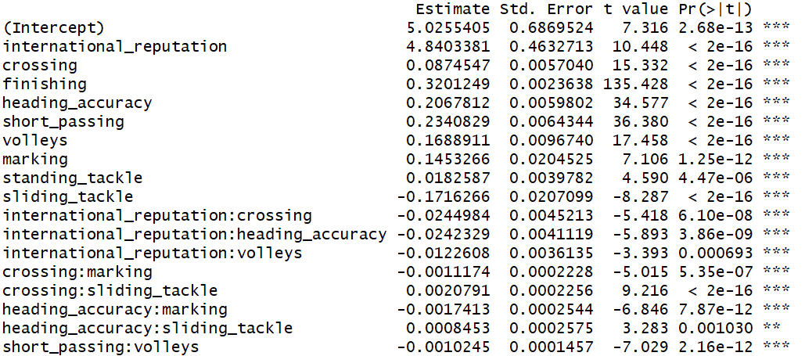
Final Model Summary
Estimated σ | 2.3
R2 | 0.94
F-statistic | 13730
p-value | 2.2e-16

Slide 11
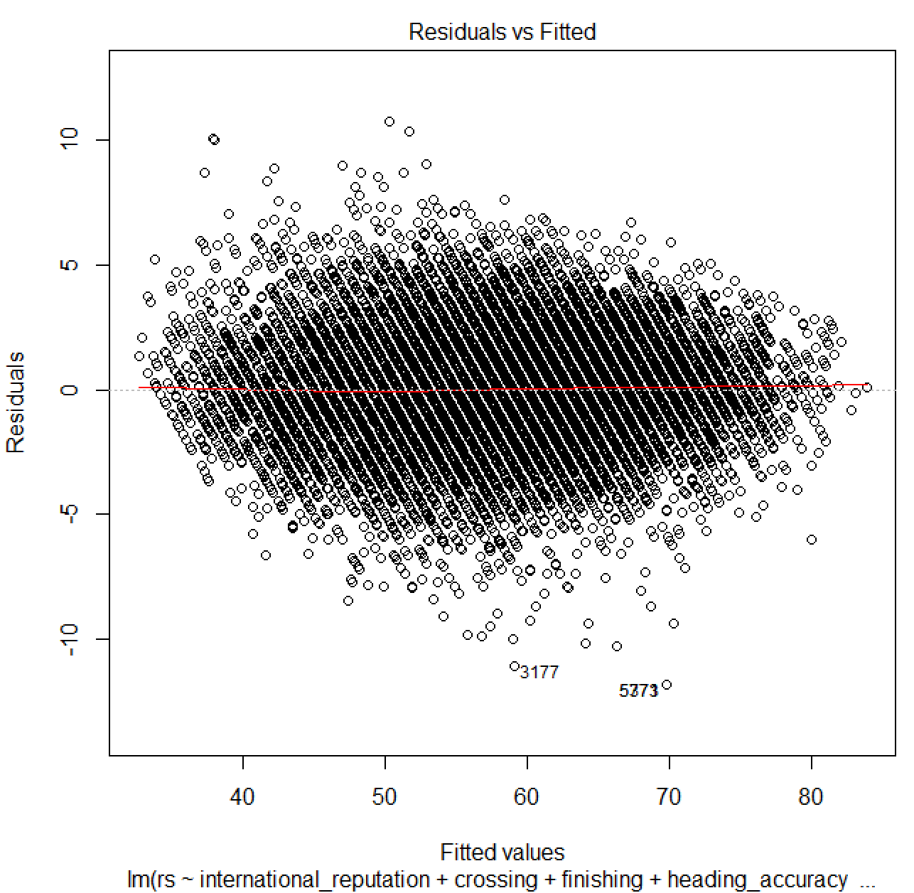
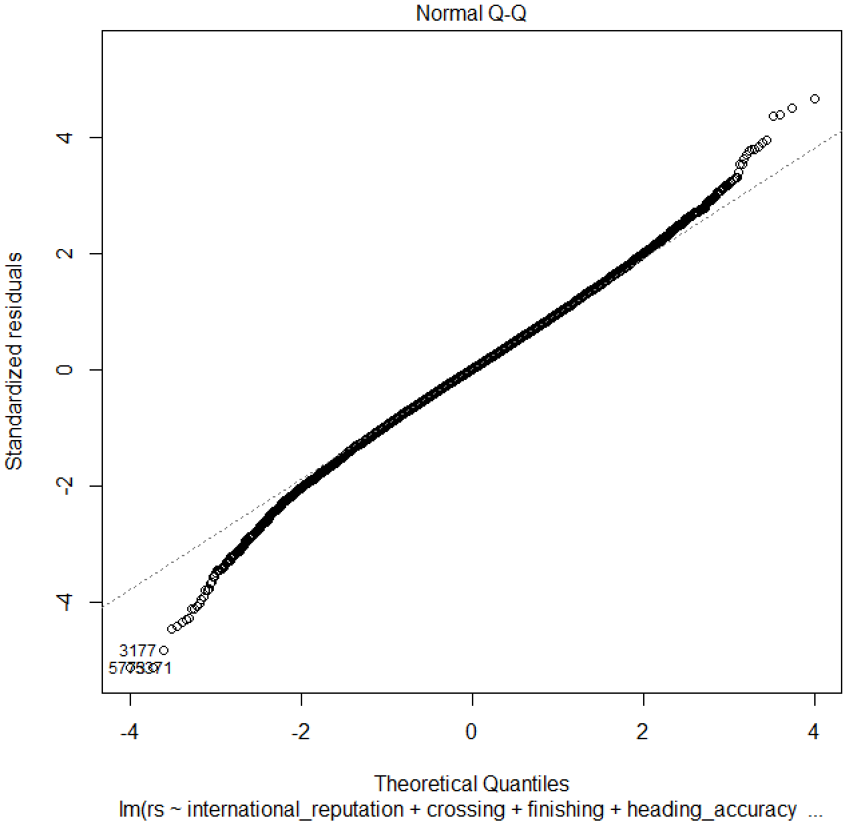
Final Model

Slide 12
Final Model
rs = 5.0255405 + 4.8403381*international_reputation + 0.0874547*crossing + 0.3201249*finishing + 0.2067812*heading_accuracy + 0.2340829*short_passing + 0.1688911*volleys + 0.1453266*marking + 0.0182587*standing_tackle -0.1716266*sliding_tackle - 0.0244984*(international_reputation*crossing) -0.0242329*(international_reputation*heading_accuracy) -0.0122608*(international_reputation*volleys) - 0.0011174*(crossing*marking) + 0.0020791*(crossing*sliding_tackle) - 0.0017413*(heading_accuracy*marking) + 0.0008453*(heading_accuracy*sliding_tackle) - 0.0010245*(short_passing*volleys)

Slide 13
Thank You

